Slide 1
Lecture 1: Introduction to Java Programming

Slide 2
Java Introduction
Introduction
Definition: A high-level, platform-independent, object-oriented programming language.
Features: Write Once, Run Anywhere (WORA), Robust, Secure, Multithreaded.
Key Features of Java
Object-Oriented
Platform-Independent (Write Once, Run Anywhere)
Robust and Secure

Slide 3
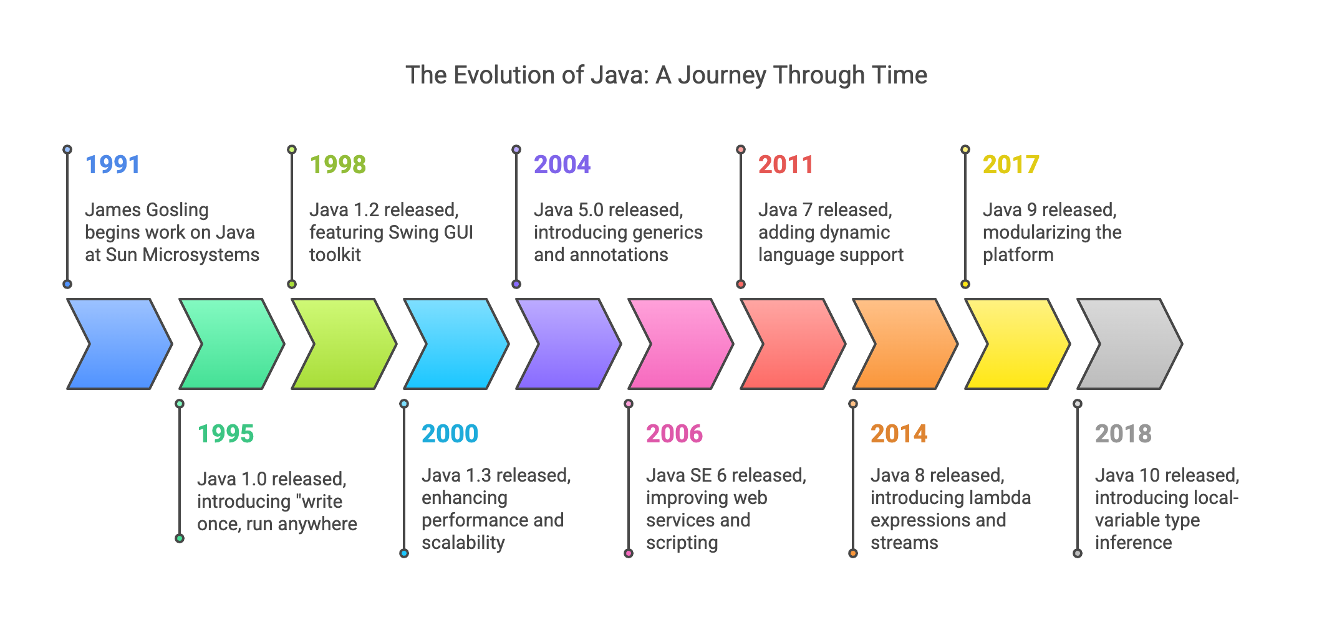

Slide 4
Java’s Popularity
Why is Java Popular?
Used in Web, Mobile, and Enterprise Applications
Community Support and Rich Libraries
Multi-threading and Distributed Computing

Slide 5
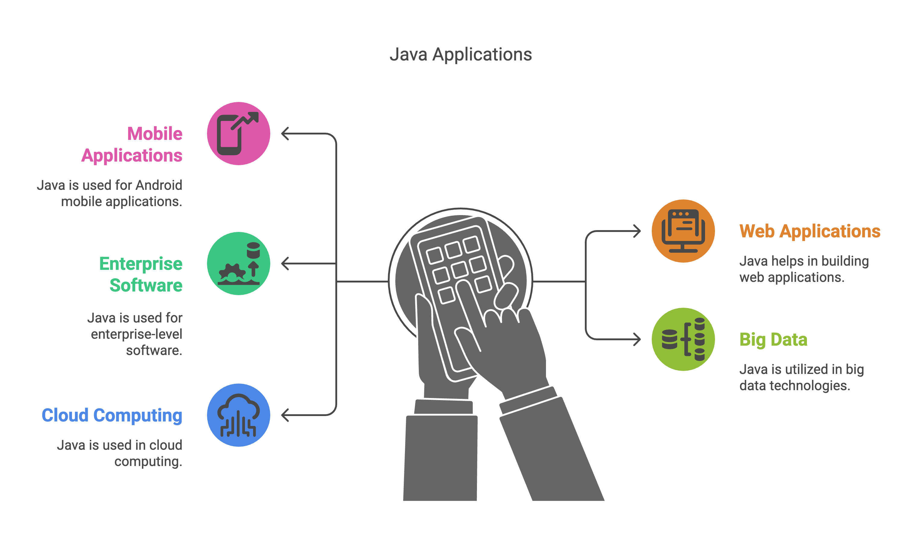

Slide 6
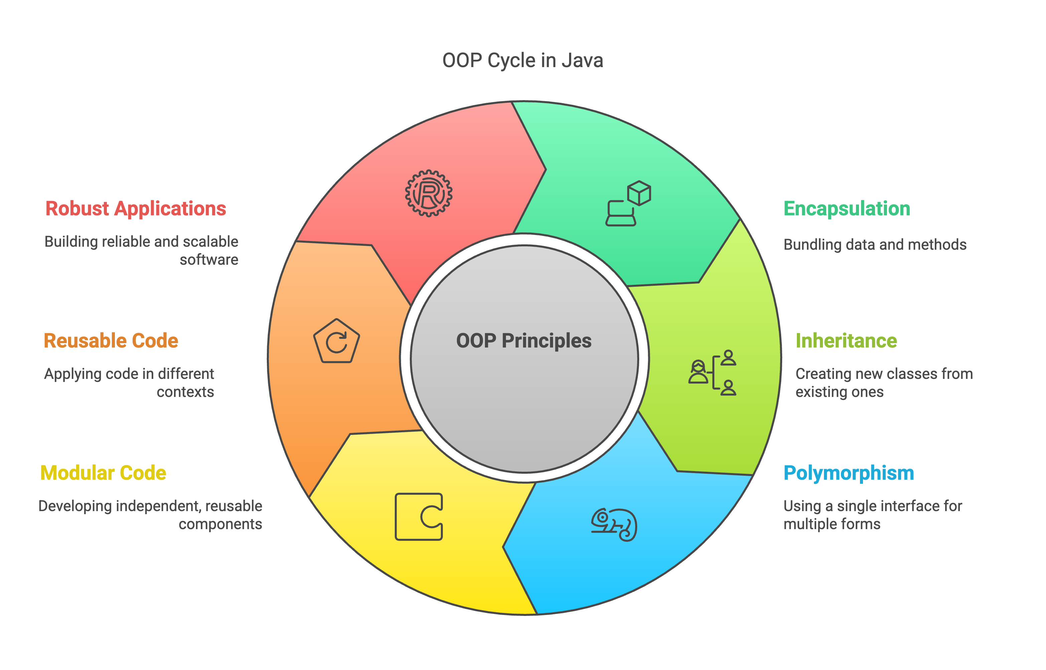

Slide 7
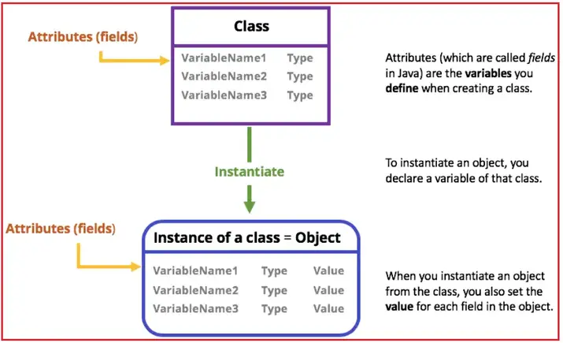
OOP in Java
Real-world Examples:
Encapsulation in Java Classes
Inheritance in Class Hierarchies
Polymorphism with Method Overriding

Slide 8
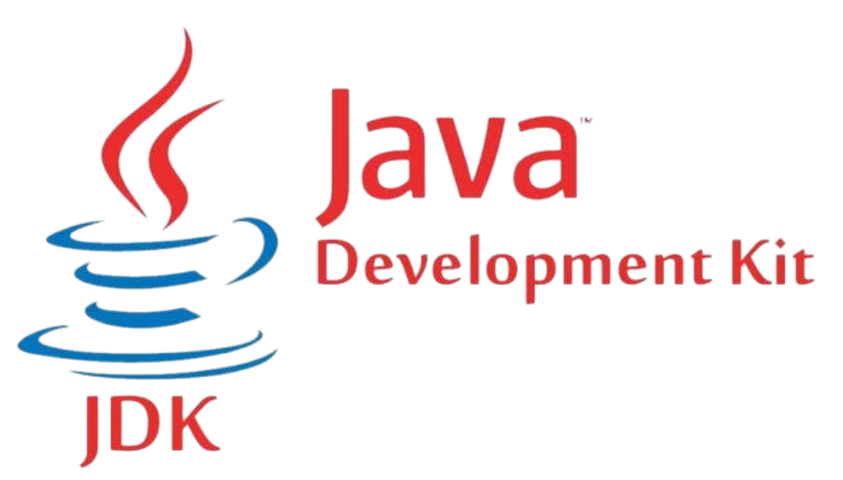
What is JDK?
Definition:
A software development kit for building Java applications.
Includes tools, libraries, and compilers.

Slide 9

Tools in JDK
• Common Tools:
javac: Compiles Java code
java: Runs Java programs
javadoc: Generates documentation

Slide 10
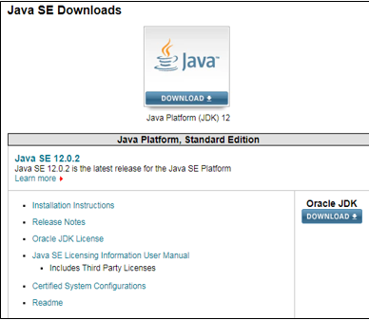
Installing and Setting up JDK
Steps:
Download JDK from the Oracle website.
Set up environment variables (JAVA_HOME).
Verify installation using java -version.
Google Doc File

Slide 11
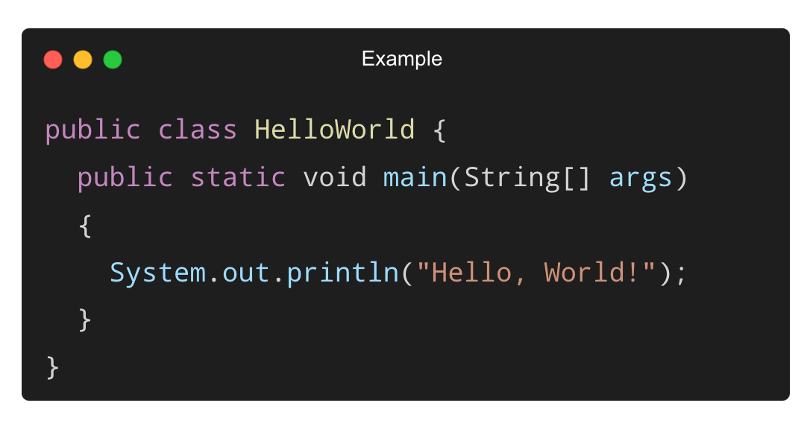
Structure of a Java Program
Components:
class Definition
main Method
Statements and Semicolons

Slide 12
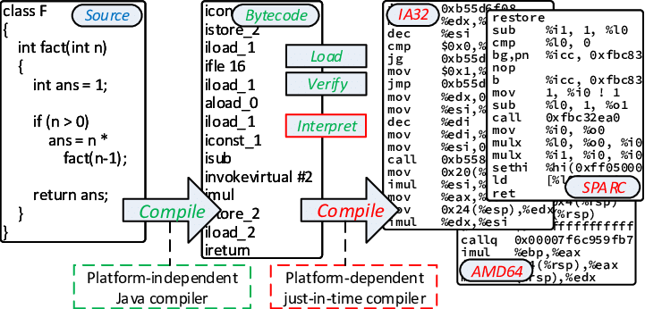
What is Java Byte Code?

Slide 13
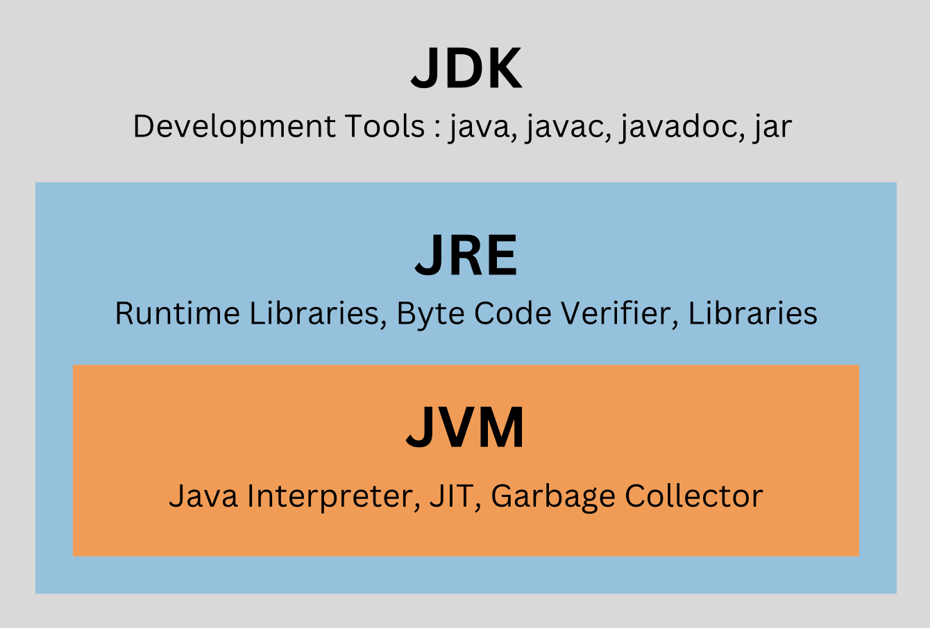
What is JDK?
JDK stands for Java Development Kit.
It includes tools for developing Java programs, such as the compiler (javac), debugger, and libraries.

Slide 14
What is JRE?
JRE stands for Java Runtime Environment.
It includes JVM and standard libraries needed to run Java applications but lacks development tools.

Slide 15
What is JVM?
JVM stands for Java Virtual Machine.
It executes Java byte code and provides a runtime environment.
JVM ensures platform independence by converting byte code into machine code specific to the host system.

Slide 16
Key Differences
Feature | JDK | JVM | JRE
Full Form | Java Development Kit | Java Virtual Machine | Java Runtime Environment
Purpose | Development | Execution | Execution
Includes Compiler | Yes | No | No
Contains JVM | Yes | Yes | Yes
Usage | Writing and running Java programs | Running Java programs | Running Java programs

Slide 17
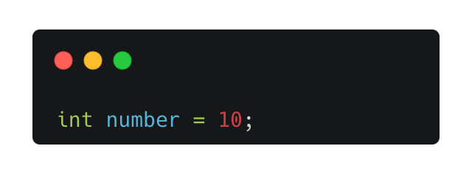
What are Variables?
Variables are containers for storing data values.
They are assigned a data type at the time of declaration.

Slide 18
Types of Variables
Local Variables: Declared within methods or blocks and accessible only there.
Instance Variables: Declared inside a class but outside methods, tied to objects.
Static Variables: Declared with the static keyword and shared across all objects of the class.

Slide 19
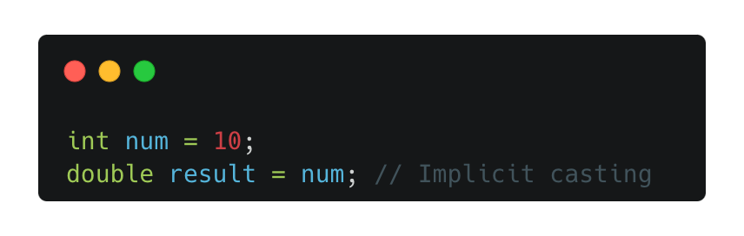
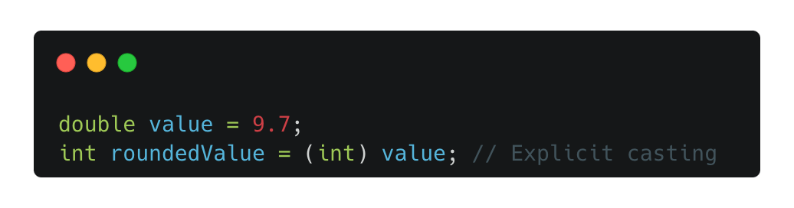
Type Casting
Implicit Type Casting (Widening):
Automatically performed by the compiler when converting from a smaller to a larger data type.
Example:
Explicit Type Casting (Narrowing):
Must be manually performed when converting from a larger to a smaller data type.
Example:

Slide 20
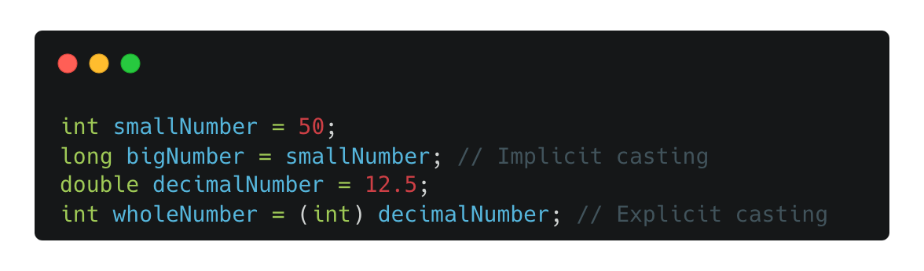
Type Casting in Action
Practical Example:

Slide 21
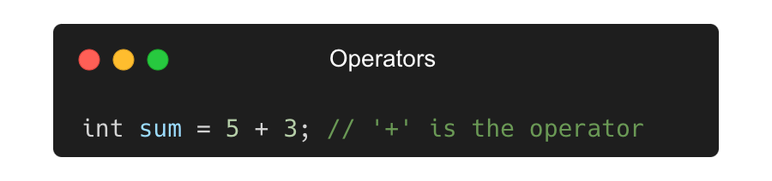
What are Operators?
Operators are symbols that perform operations on variables and values.

Slide 22
Types of Operators in Java
Types of Operators in Java
Arithmetic Operators: +, -, *, /, %
Used for basic mathematical calculations like addition.
Relational Operators: ==, !=, >, <, >=, <=
Used to compare two values and return a Boolean result.
Logical Operators: &&, ||, !
Used to perform logical operations on Boolean values.
Bitwise Operators: &, |, ^, ~, <<, >>
Operate on binary representations of integers at the bit level.
Assignment Operators: =, +=, -=, *=, /=, %=
Used to assign values to variables with various methods.

Slide 23
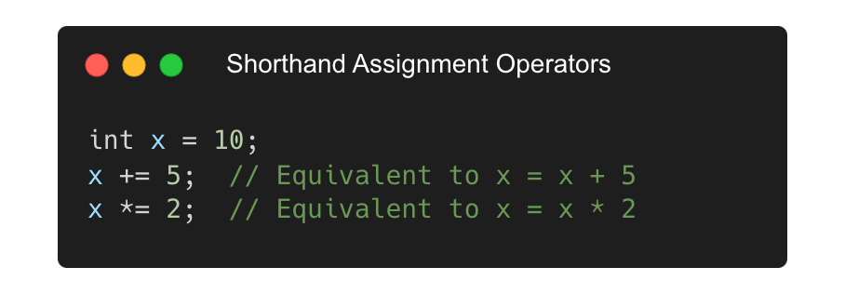
Shorthand Assignment Operators
Simplifies repetitive operations by combining them with assignment.
Example:

Slide 24
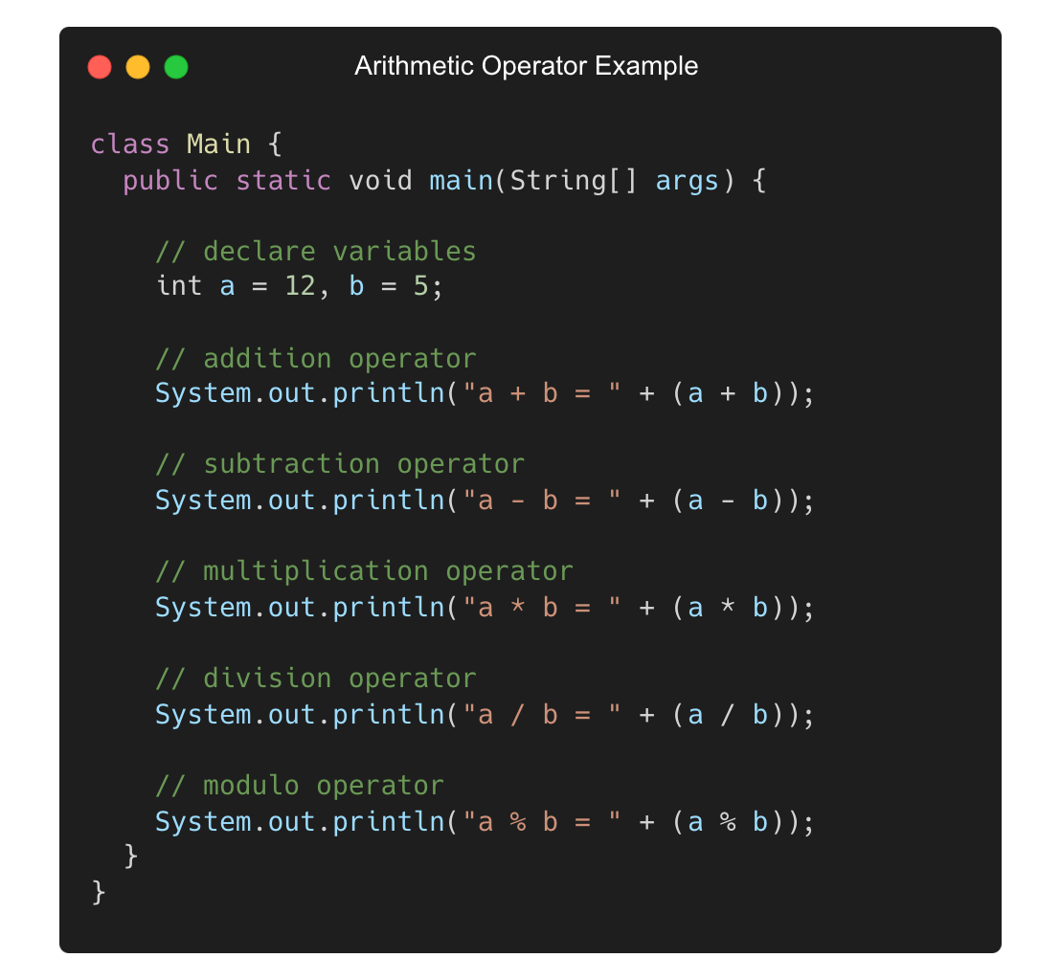
Practical Example of Arithmetic Operators

Slide 25
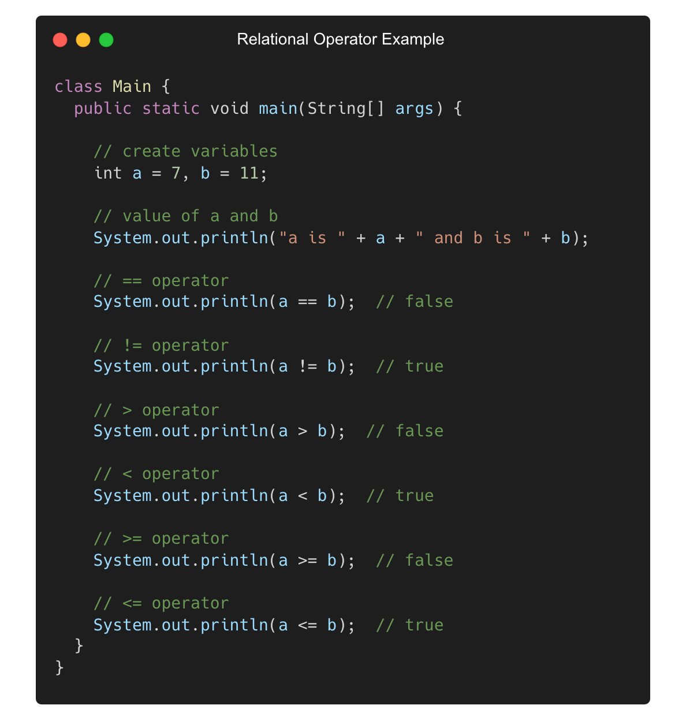
Practical Example of Relational Operators

Slide 26
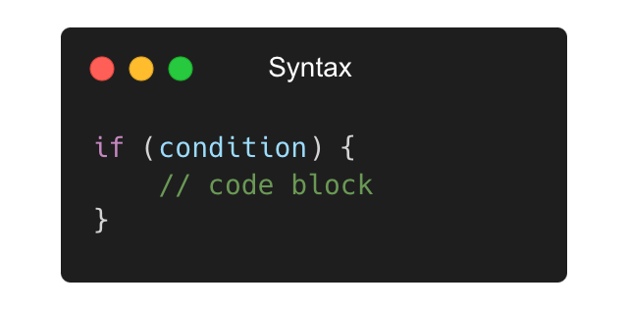
What are Control Statements?
Control statements direct the flow of execution based on conditions.
Example:

Slide 27
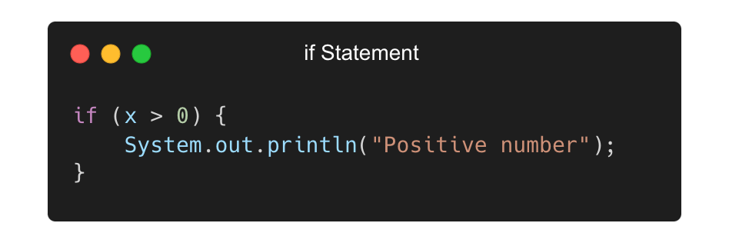
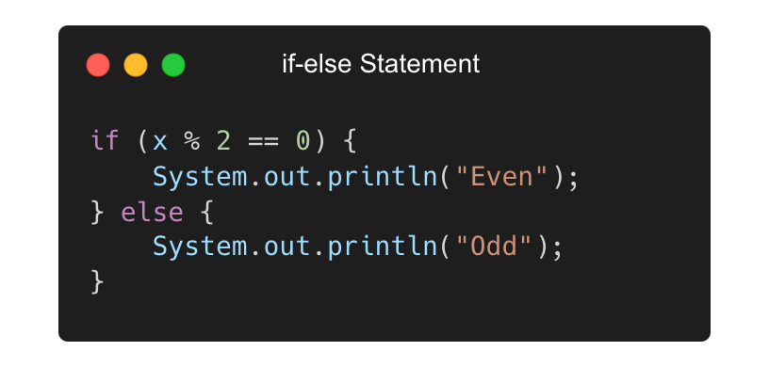
Types of Control Statements
if Statement: Executes code if the condition is true.
if-else Statement: Executes one block if the condition is true; otherwise, executes another block.

Slide 28
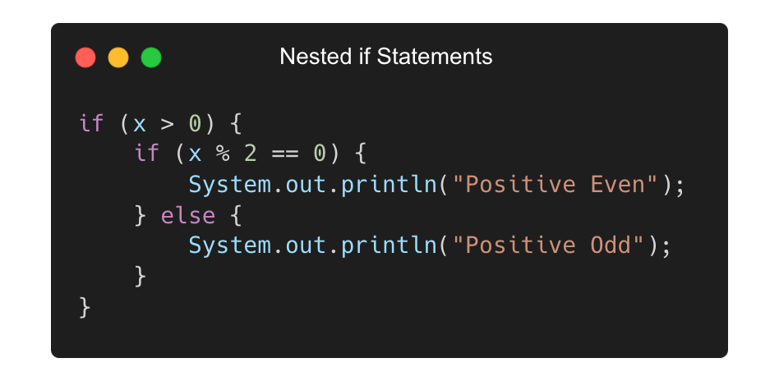
Nested if Statements
Allows multiple levels of decision-making by placing if or if-else inside another if.

Slide 29
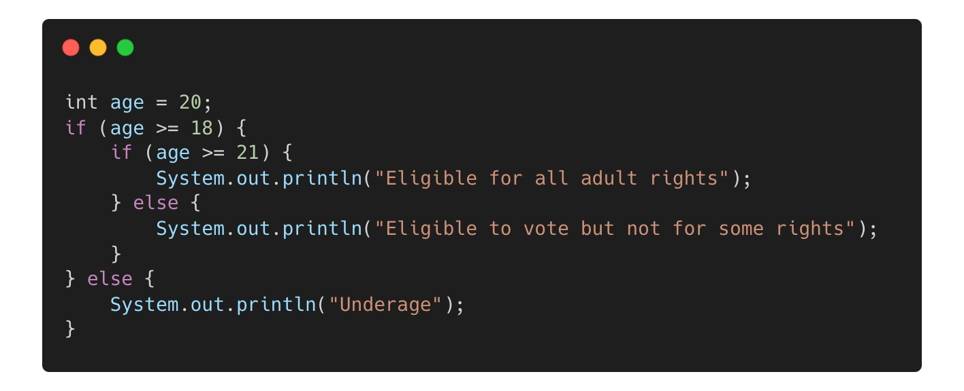
Practical Example
Real-world Scenario:

Slide 30
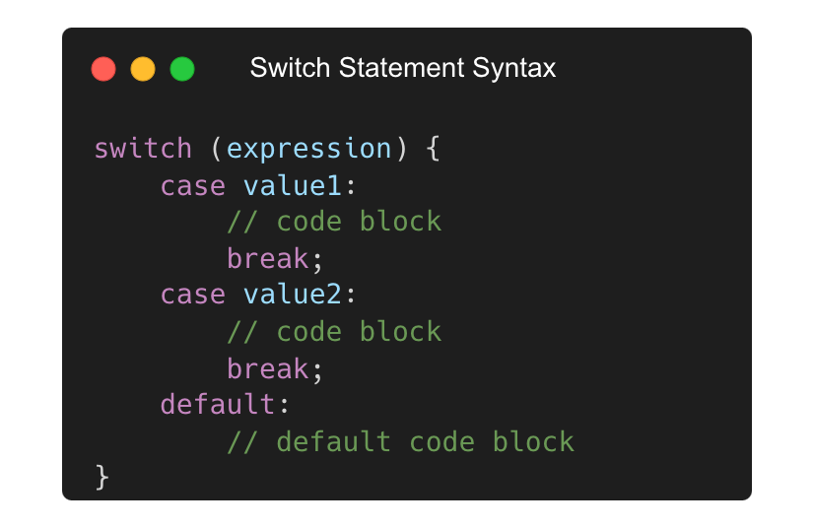
What is a Switch Statement?
A control statement that executes one block of code from multiple options based on a variable’s value.
Example:

Slide 31
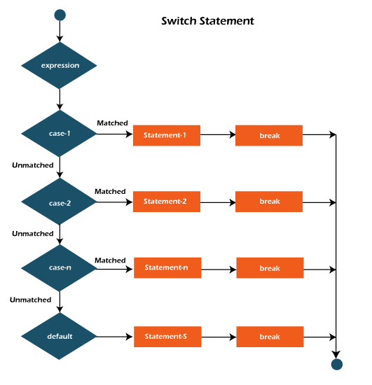
Key Features of Switch Statements
Simplifies handling of multiple conditions.
Supports data types: int, char, String, enum (starting from Java 7).
break keyword prevents fall-through to subsequent cases.
default case handles unmatched conditions.

Slide 32
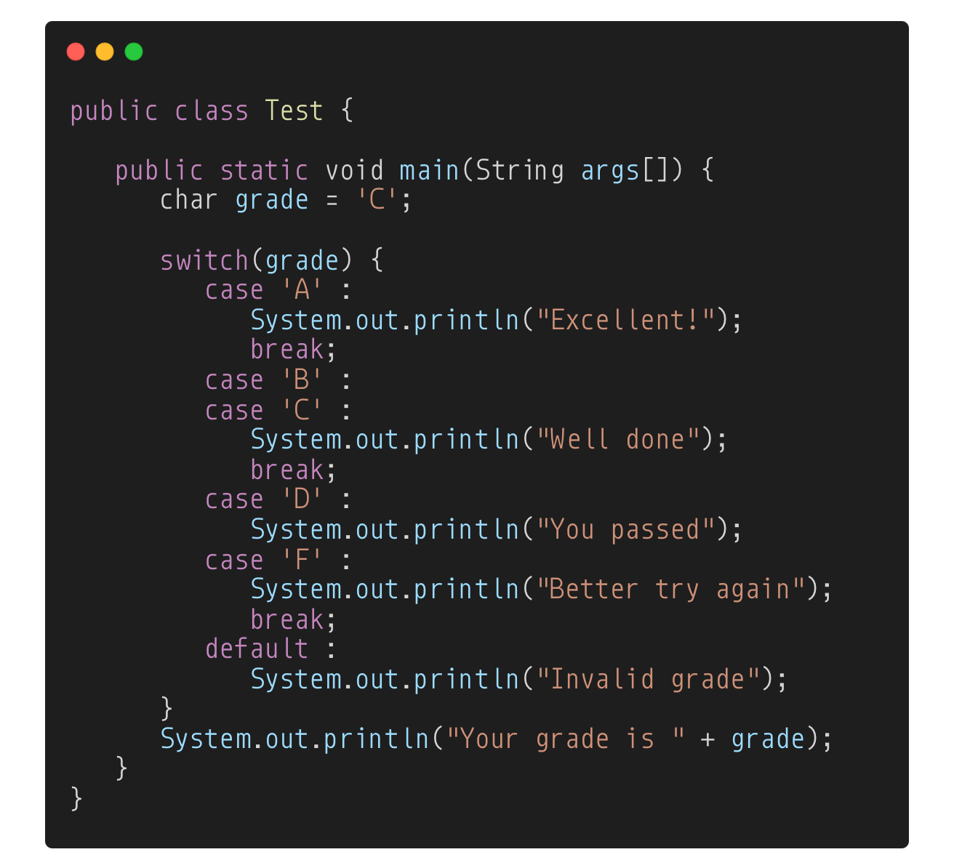
Practical Examples
Output:
Well done
Your grade is C

Slide 33
What are Loops?
Loops are control structures that allow a block of code to execute repeatedly until a specific condition is met.
Types of Loops in Java:
for loop
while loop
do-while loop

Slide 34
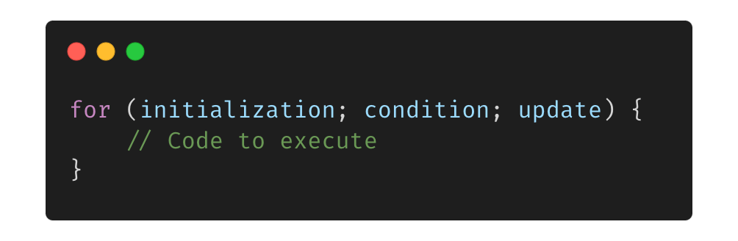
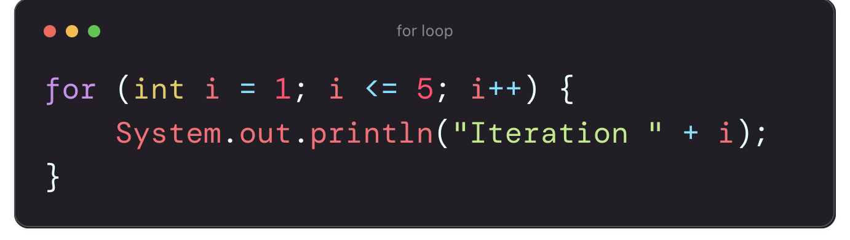
The for loop
The for loop is used when the number of iterations is known beforehand.
Syntax:
Example:

Slide 35
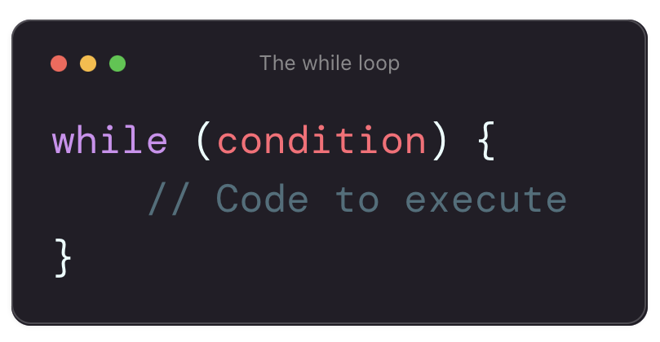
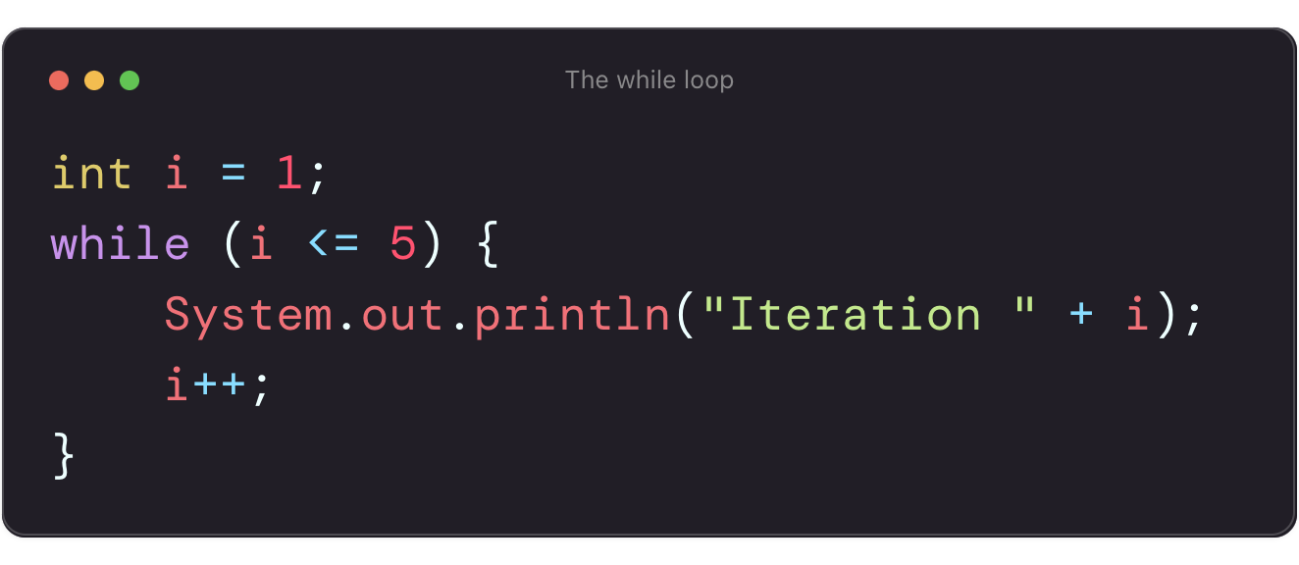
The while loop
The while loop executes as long as the given condition is true.
Syntax:
Example:

Slide 36
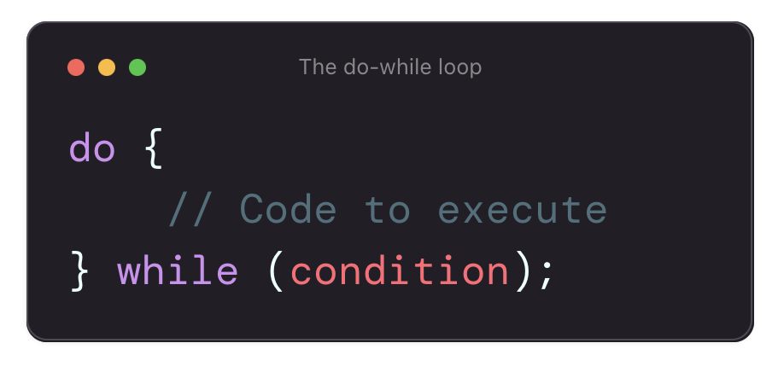
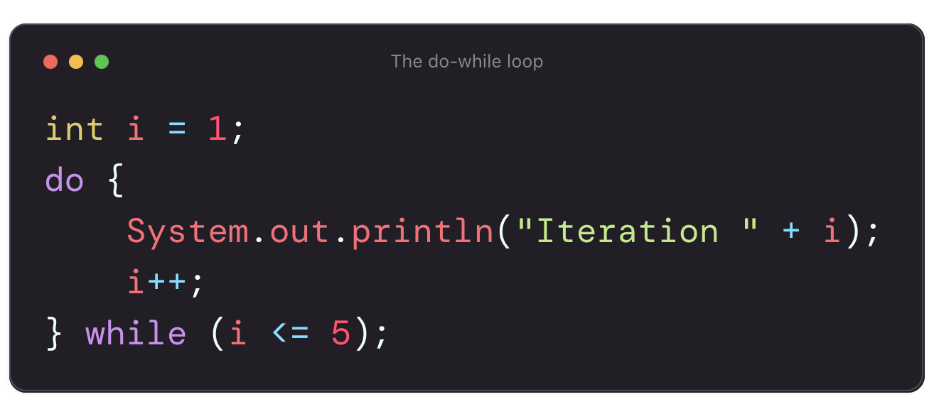
The do-while Loop
The do-while loop executes at least once before checking the condition.
Syntax:
Example:

Slide 37
Differences Between Loops
Feature | for Loop | while Loop | do-while Loop
Condition Check | Before execution | Before execution | After first execution
Best Used For | Known Iterations | Unknown iterations | Ensuring at least one execution
Example Usage | Counting, Arrays | User input, Events | Menu-driven programs

Slide 38
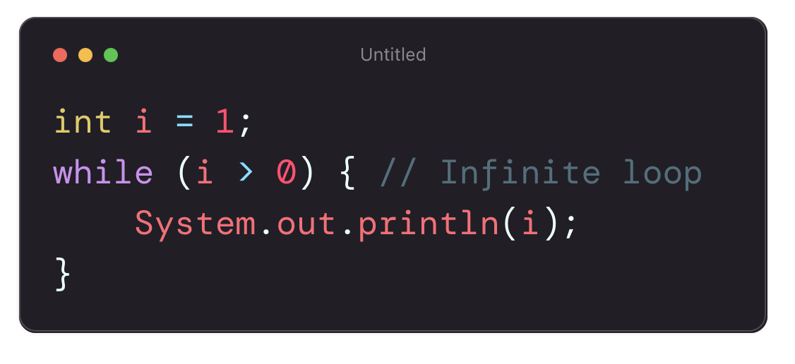
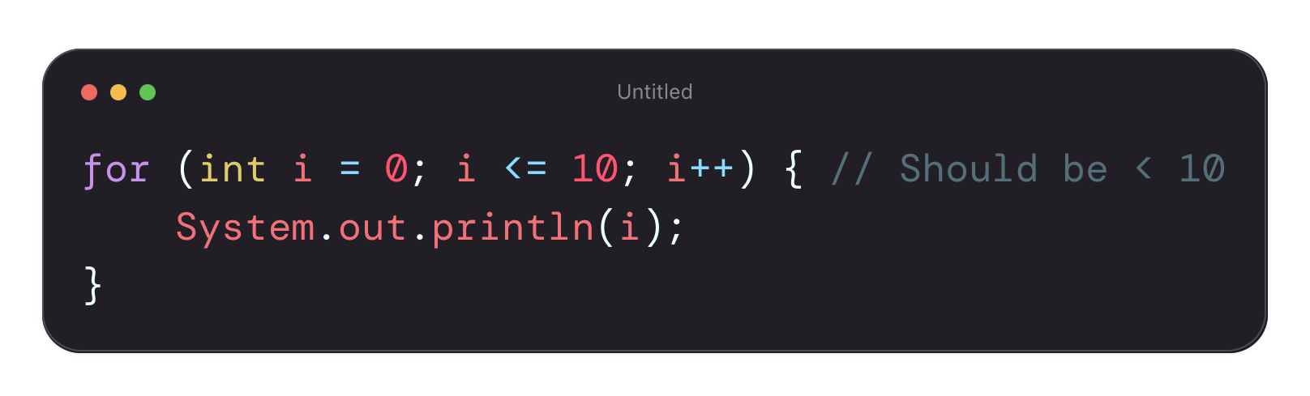
Common Mistakes with Loops
Infinite Loops: Forgetting to update the loop variable.
Off-by-One Errors: Incorrect loop termination condition

Slide 39
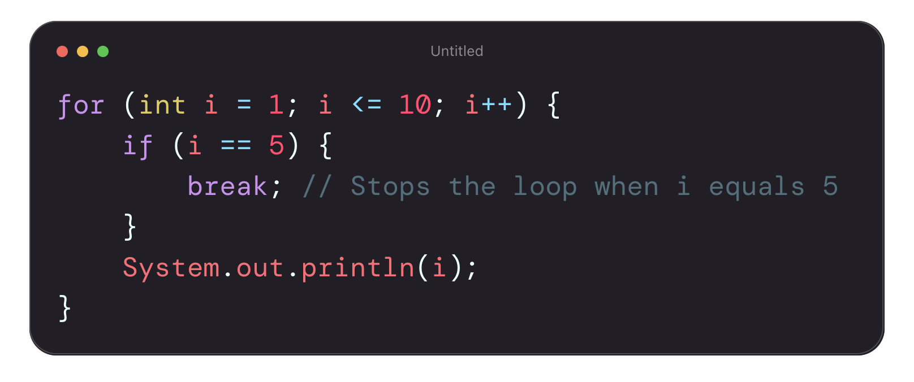
The break Statement
Used to exit a loop immediately when a condition is met.
Example:
Output: 1 2 3 4

Slide 40
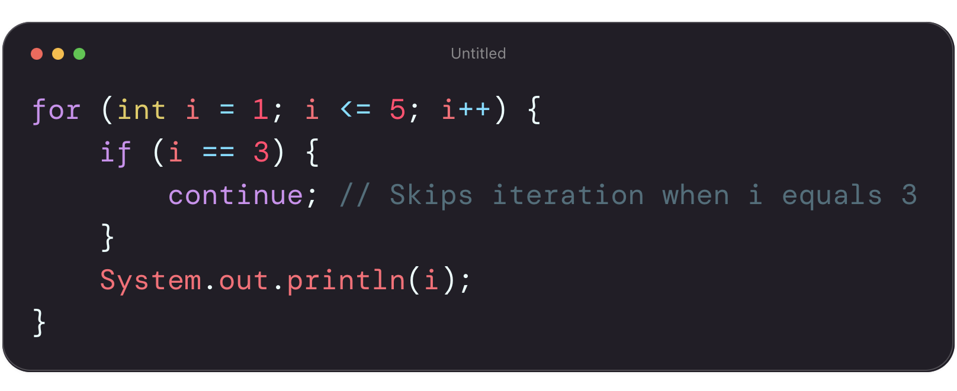
The continue Statement
Used to skip the current iteration and move to the next one.
Example:
Output: 1 2 4 5

Slide 41
When to use ‘break’ and ‘continue’
Statement | Function | Example Use Case
break | Exits the loop immediately | Exiting a loop when a condition is met (e. g., searching for an element)
continue | Skips the current iteration and continues to the next. | Skipping unwanted values (e.g., filtering even numbers)

Slide 42
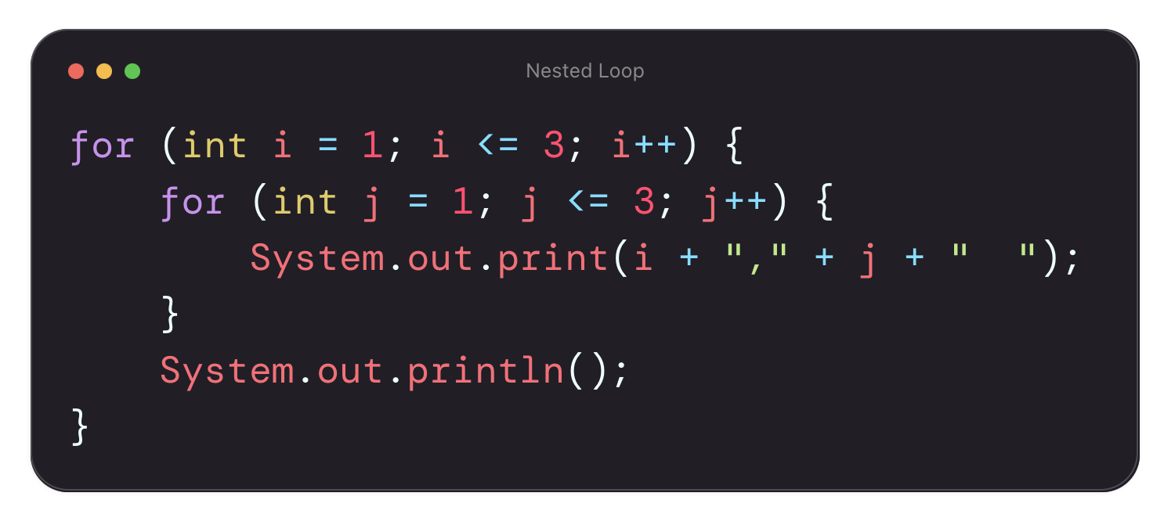

Nested Loops in Java
A loop inside another loop.
Useful for multi-dimensional arrays, pattern printing, and complex iteration logic.
Example:
Output:

Slide 43
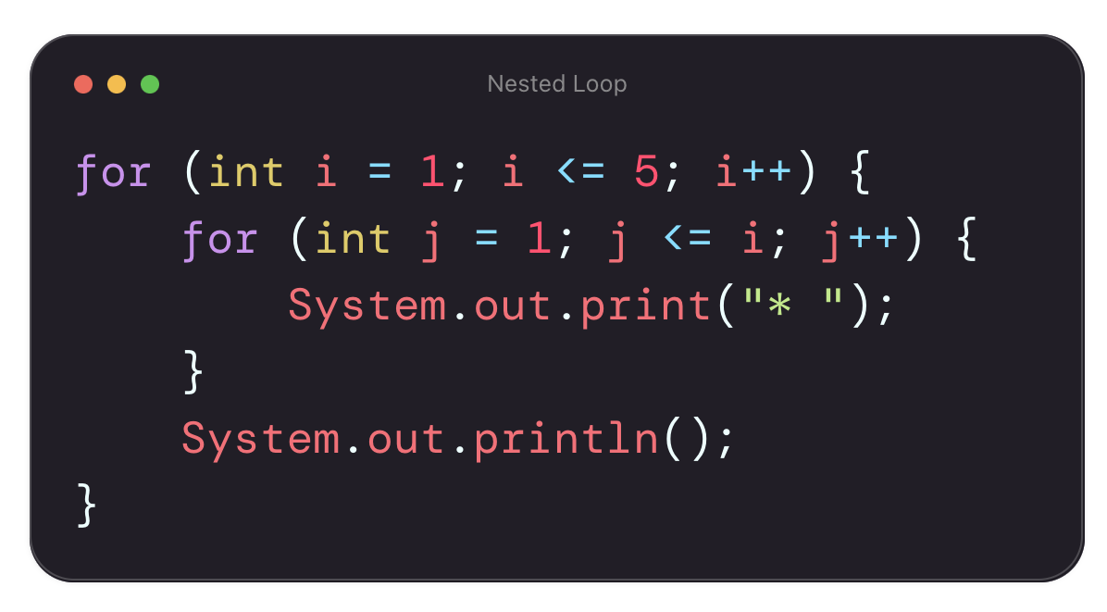
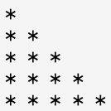
Practical Application of Nested Loops
Use Cases of Nested Loops:
Printing patterns
Processing multi-dimensional arrays
Creating multiplication tables
Example: Printing a Pattern
Output:

Slide 44
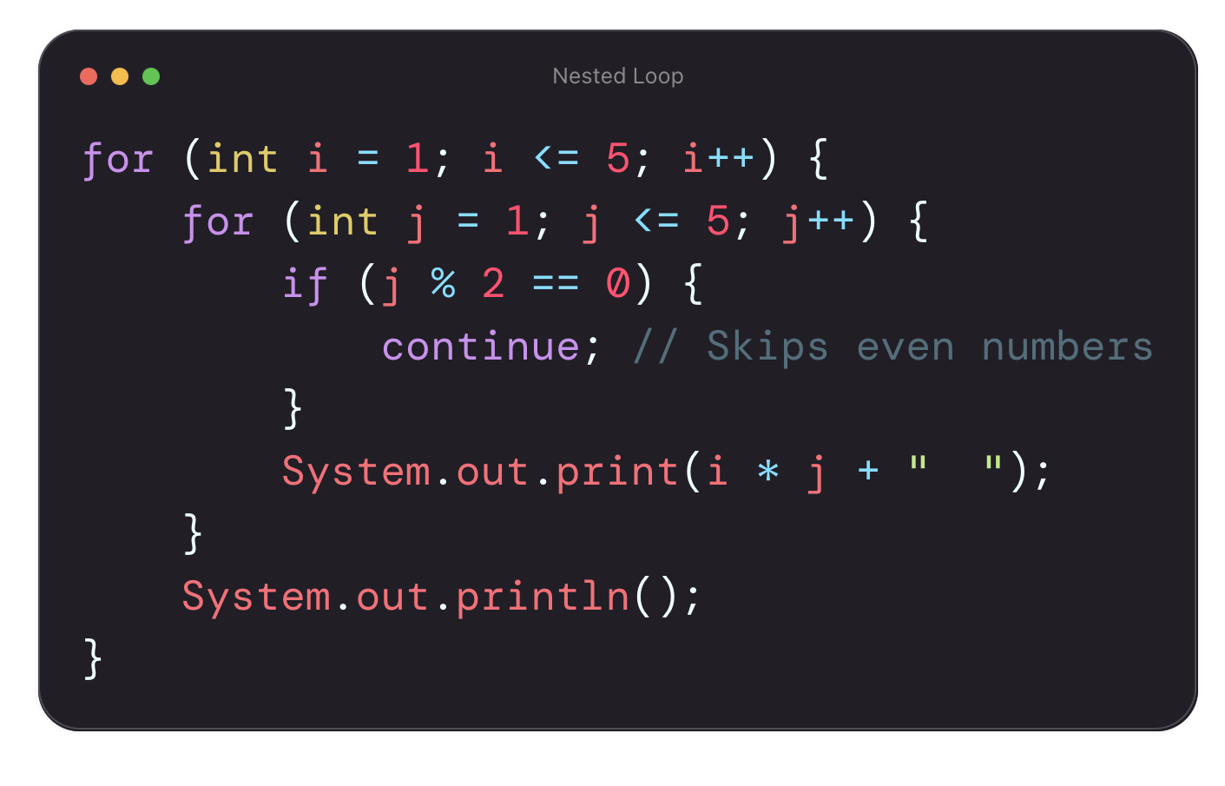
Combining ‘break’ and ‘continue’ in Nested Loops
Example: Skipping even numbers in a multiplication table.

Slide 45
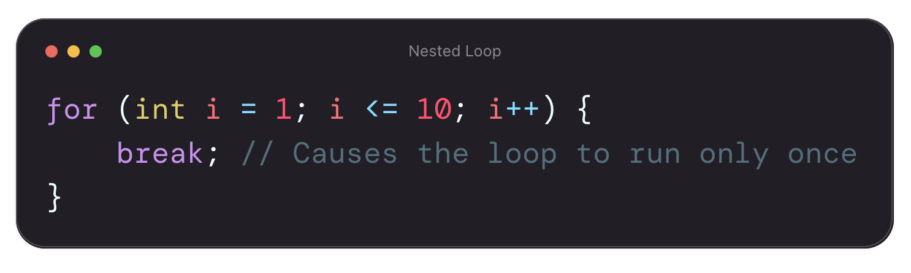
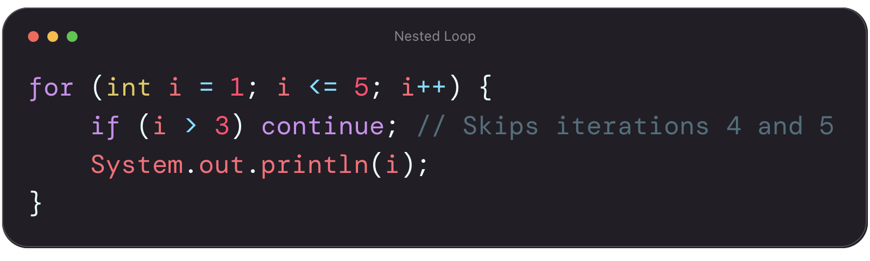
Common Mistakes with ‘break’, ‘continue’, and Nested Loops
Incorrect use of break leading to premature termination.
Skipping required iterations with continue

Slide 46
THANK YOU

